Slide 1
BBC micro:bit - IEEE Girls Love Tech
Steve Case

Slide 2
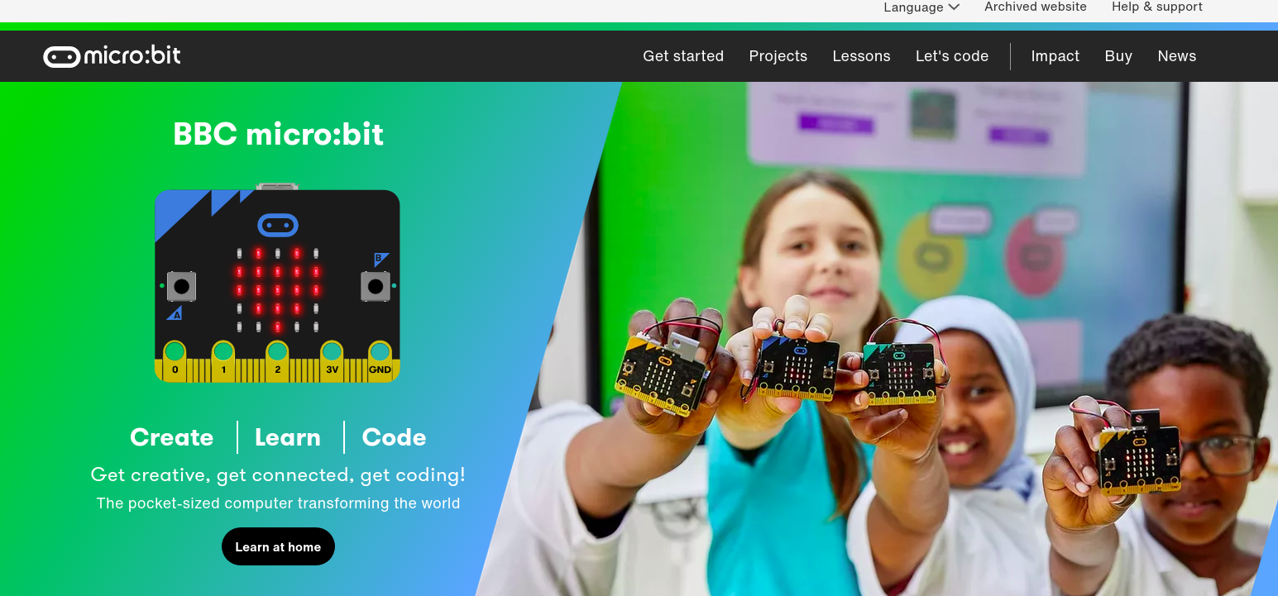
BBC micro:bit

Slide 3
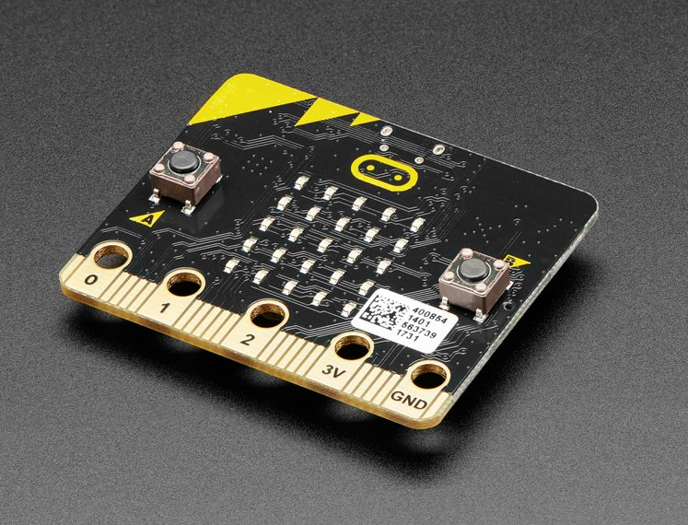
BBC micro:bit Development Board

Slide 4
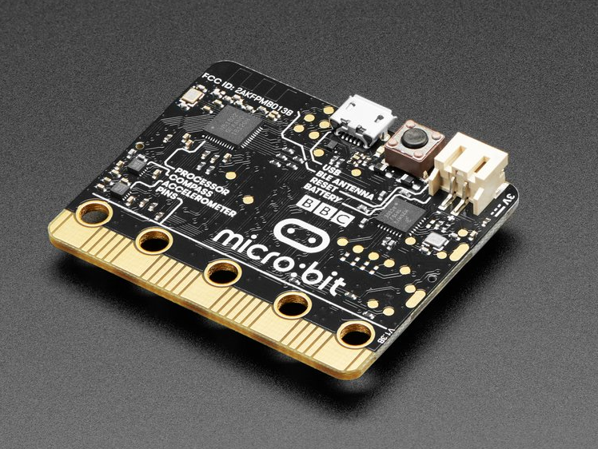
BBC micro:bit Development Board

Slide 5
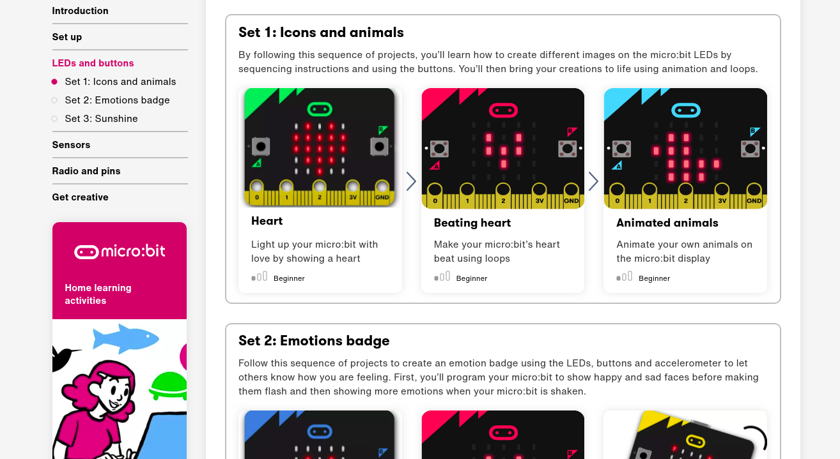
BBC micro:bit

Slide 6
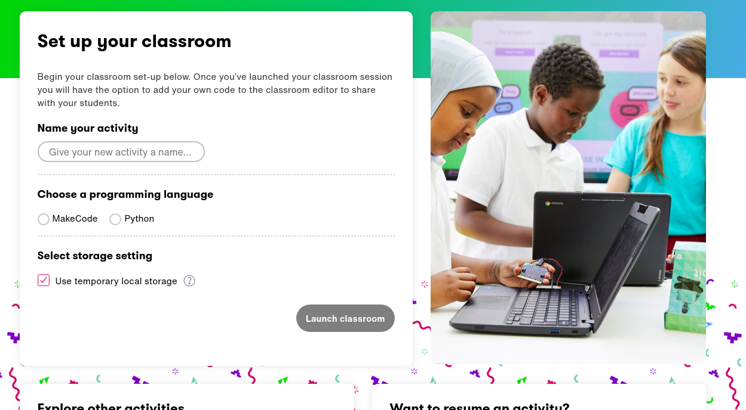
BBC micro:bit

Slide 7
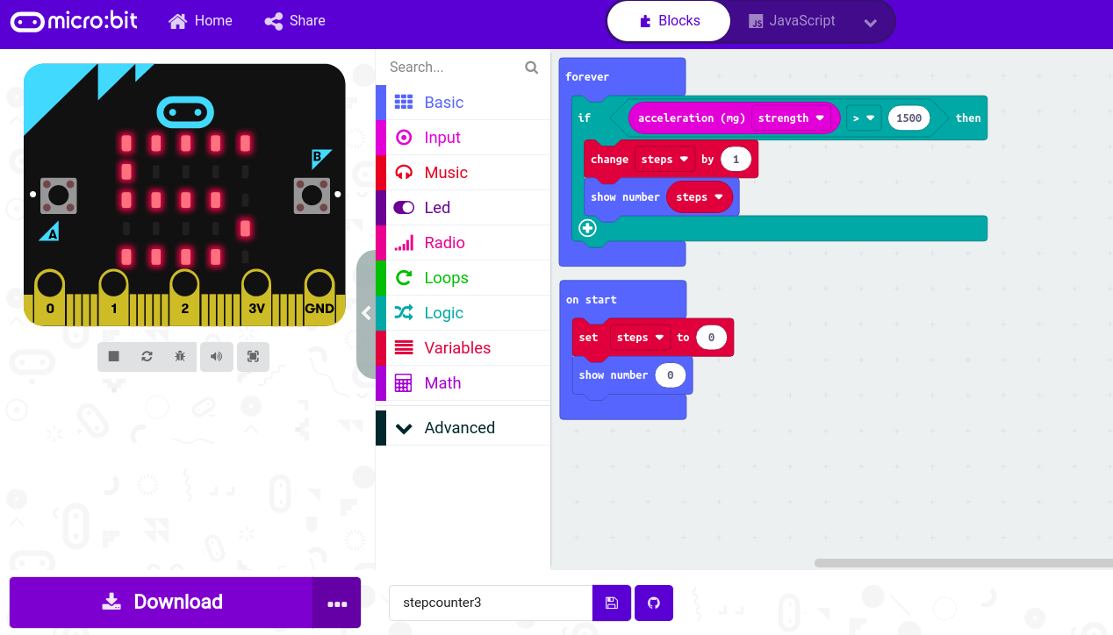
BBC micro:bit Microsoft MakeCode
Notes:
Make Code is a fantastic way to use visual tools to learn programming and to program your microbit device. Unfortunately we will not have enough time to study this tool.
You can use the tool visually, then translate the blocks into javascript scripts.
Javascript is a programming language that runs on the web. The MakeCode tool will flash the program onto the microbit.
Also - Make Code is visually very similar to the Scratch program that you can find on the Raspberry Pi and other platforms.

Slide 8
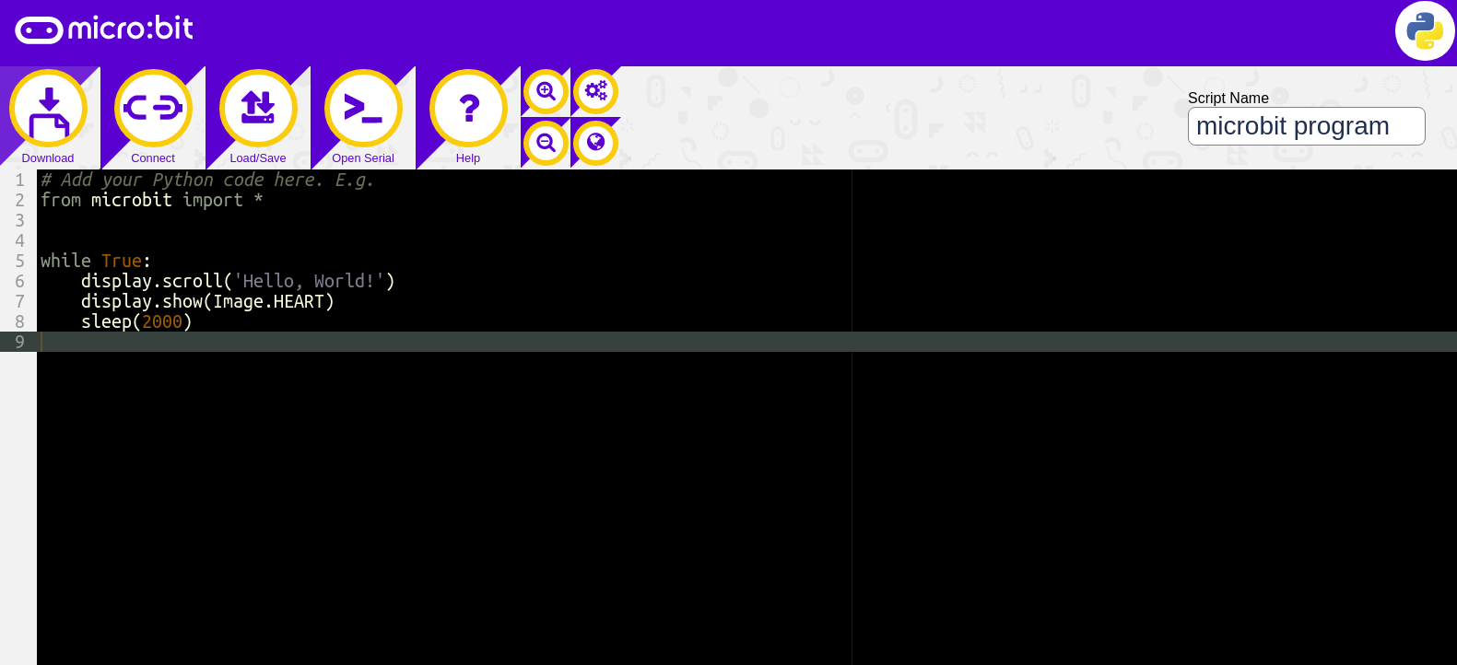
BBC micro:bit Python Editor

Slide 9
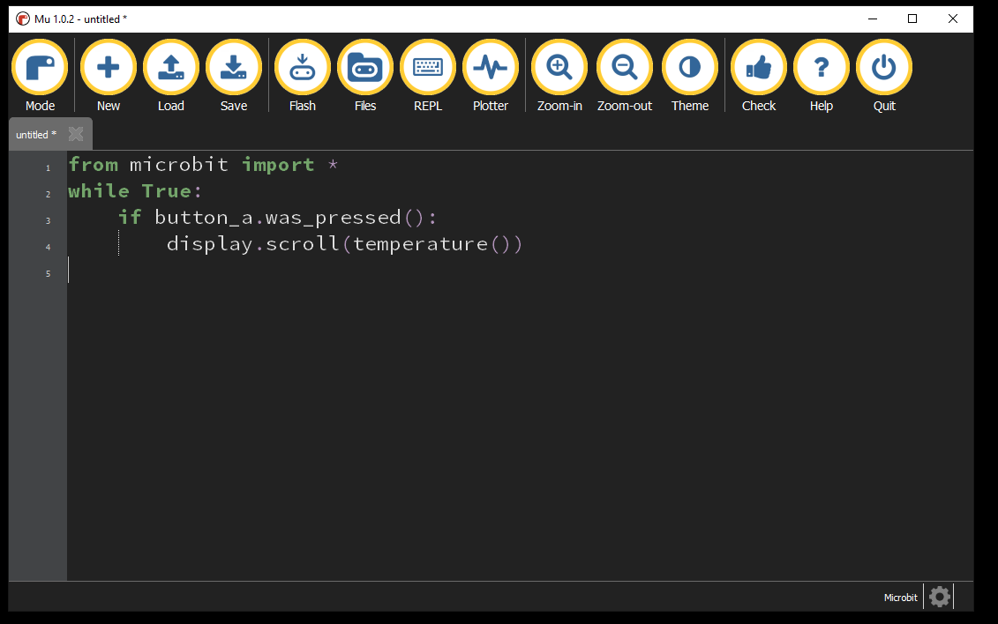
BBC micro:bit Mu Python Editor
Notes:
This is the editor that we suggest students use for editing their work. It has syntax checking and code-completion to make things a bit easier.
For online work in groups, we’ll use the bbc:microbit editor.

Slide 10
Reference material
Adafruit Industries: www.adafruit.com
Gemma M0 learning: www.learn.adafruit.com/adafruit-gemma-m0?view=all
Sparkfun electronics: www.sparkfun.com
Mu-Editor Installation:
https://codewith.mu/en/download
Seminar Slides:
https://docs.google.com/presentation/d/1-rhsECbdl-_QQHVEifSHUANQlVRY3bAzd5QX7KLlMLc/edit?usp=sharing
Python:
https://www.w3schools.com/python/default.asp
https://www.python.org/ (advanced full reference for Python)
https://wiki.python.org/moin/BeginnersGuide (still pretty advanced)
Electronics Basics Videos

